Slide 1
Quantitative Method Summary
Business Intelligence & Analytics

Slide 2
Analytical methods
Data Driven Methods
Data management competencies
Lists
One-off reports
Manual reports
On demand
Event driven
Hypothesis driven methods
1 to 1 analysis
Pairwise testing
Independent testing
1 to many analysis
Estimate
Profile
Grouping
Ranging
Exploratory techniques
Data reduction
Cluster analysis
Cross sales analysis
Up-sales analysis
Data mining with a target variable
Prediction of
Estimate
Profile
Grouping
Ranging
Notes:
Analytics staff need to be familiar with the different levels, how they relate and when they need to be executed. Staff who don’t have training in the higher levels need to understand when to get more advanced analysts involved

Slide 3
Data management techniques
Data management competencies
Lists
One-off reports
Manual reports
On demand
Event driven
Data management
Descriptive statistics – no hypothesis testing done
Classified into automated or ad hoc reports
Generally the most frequent use of a data warehouse
Reports will generally be updated at some interval
May want to control users’ read access to the reports

Slide 4
Data management techniques
Data management competencies
Lists
One-off reports
Manual reports
On demand
Event driven
One-off reports
Often referred to as ”ad hoc” reports
The requestor usually needs to specify how the table or report is to be designed
Filters, aggregation levels, format
Trend to push ad hoc requests back on the user – several vendors targeting this space
Another trend – systems that understand speech
As this becomes easier, analytics staff required to train the business
Also required to set boundaries on what can be done self-serve and what requires analytics resources

Slide 5
Data management techniques
Data management competencies
Lists
One-off reports
Manual reports
On demand
Event driven
Manual reports
Normally used in connection with projects
Limited lifetime, not viable to put into “production”
Sometimes chosen as a solution b/c requirements keep changing
Not uncommon for the analyst to get stuck creating the report (drowning in your own success)
Can breed “multiple versions of the truth”
Should be moved to automated process if possible

Slide 6
Data management techniques
Data management competencies
Lists
One-off reports
Manual reports
On demand
Event driven
On-demand reports
Provided by data warehouse, viewed only when the user requests it
Most are interactive
Can be broken down into other dimensions
Generally provided by a front-end user interface

Slide 7
Data management techniques
Data management competencies
Lists
One-off reports
Manual reports
On demand
Event driven
Event driven reports
Same as on-demand reports – these reports remind the user to read them
Can be sent to email at regular intervals
OR when some critical value has been exceeded (alerting)
Alerting used when metrics (or KPIs) are over/under their target values as specified by company strategy

Slide 8
Final notes on reporting
Typically contain lag information
Reports are defined by the need to support a specific business strategy
A set of reports should “communicate” with one another – results should match across contexts
The business should know who is responsible for any corrective action
Single version of the truth

Slide 9
Hypothesis driven methods
Hypothesis driven methods
1 to 1 analysis
Pairwise testing
Independent testing
1 to many analysis
Estimate
Profile
Grouping
Ranging
1 to 1 analysis
Use statistical methods to examine the relationship between two variables
Includes things like correlations and t-tests
Statistical tests produce something called p-values
The use of p-values is pretty hotly contested at the moment for reasons mentioned in the text
Note, however, that p-values will not produce false results “every 20th time” as the text states – the problem is that you don’t know which time is the 20th

Slide 10
Hypothesis driven methods
Hypothesis driven methods
1 to 1 analysis
Pairwise testing
Independent testing
1 to many analysis
Estimate
Profile
Grouping
Ranging
1 to many analysis
Tests that handle several input variables at once
Reveal how input variables are combined to predict a dependent variable
A dependent variable is some variable of interest either for prediction or insight
Scaling of the dependent variable determines what kind of model we use
Linear regression – standard quantitative variable
Logistic regression – yes/no variable

Slide 11
Hypothesis driven methods
Hypothesis driven methods
1 to 1 analysis
Pairwise testing
Independent testing
1 to many analysis
Estimate
Profile
Grouping
Ranging
1 to many analysis
Scaling of the dependent variable determines what kind of model we use
Linear regression – standard quantitative variable
Logistic regression – yes/no variable
Ordinal regression – ordered categorical data
Generalized linear model – unordered categorical data

Slide 12
Hypothesis driven methods
Hypothesis driven methods
1 to 1 analysis
Pairwise testing
Independent testing
1 to many analysis
Estimate
Profile
Grouping
Ranging
1 to many analysis
Models used to
Create predictions
Or create insight
The model will create a function that relates the inputs to the dependent variable
That function can be interpreted to learn from relationships in the data

Slide 13
Notes about data mining
Projects generally take a few weeks at a minimum
Can take longer depending on data quality and volume
Will require specialized software and skills
Accuracy measured by holding out a set of data and testing models on the held-out data
The purpose of the model is to act on the results by updating future data
Notes:
Note the difference is that statistical models assume an underlying structure and make specific assumptions so they are theoretically sound

Slide 14
Data driven methods
Exploratory techniques
Data reduction
Cluster analysis
Cross sales analysis
Up-sales analysis
Exploratory techniques
Allow algorithms to discover tendencies in data
There is no target variable
Often times these techniques leverage more art than science
Always a danger that the insights you come up with are particular to the data you are using rather than global insights

Slide 15
Data driven methods
Exploratory techniques
Data reduction
Cluster analysis
Cross sales analysis
Up-sales analysis
Data Reduction
Take information from a large number of variables and condense it into a smaller number of variables (most often 2 so we can create a scatterplot)
One example – survey data where we ask a large battery of questions and condense it into only a few dimensions
Methods include
Principal component analysis (PCA)
Factor analysis
Correspondence analysis

Slide 16
Data driven methods
Exploratory techniques
Data reduction
Cluster analysis
Cross sales analysis
Up-sales analysis
Cluster Analysis
Groups the rows of data
Used to understand if there are natural groupings of rows (often individual consumers)
Also often used on questionnaire data
And often used in conjunction with data reduction techniques

Slide 17
Data driven methods
Exploratory techniques
Data reduction
Cluster analysis
Cross sales analysis
Up-sales analysis
Cross sales Analysis
Basket analysis models
Show us which items are purchased together most often
Used to generate combined offers

Slide 18
Data driven methods
Exploratory techniques
Data reduction
Cluster analysis
Cross sales analysis
Up-sales analysis
Upsell Analysis
Looking at buckets of purchases over time
Used to discover when someone will purchase more of a product
And when they will purchase it

Slide 19
Data driven methods
Data mining with a target variable
Prediction of
Estimate
Profile
Grouping
Ranging
Data with a target
Neural networks (deep learning) – handle a great deal of complexity
Tend to be used for things like speech recognition or image detection
Models too complex to use for gaining insight
Decision trees – understandable set up
Today most models include groups of decision trees which can make them difficult to interpret
Tend to be easy to setup, run quickly and are very accurate

Slide 20
Statistical models vs machine learning models
Statistical models
Assume an underlying structure and make specific assumptions so they are theoretically sound
Generally estimated using mathematical formulas
Used more for gaining insight about data
Machine Learning models
Machine Learning (data mining) – have few, if any, assumptions about the data and focus, instead, on prediction accuracy
Generally estimated using random starting points and guessing new values until the prediction is as accurate as possible
Used more when prediction accuracy is the primary goal

Slide 21
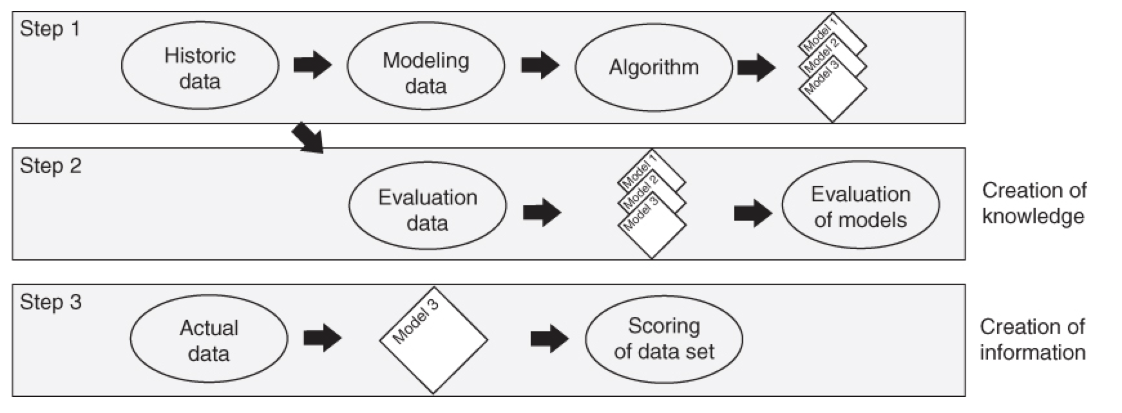
Notes about data mining

Slide 22
Reviewed in more detail quantitative methods from the prior section

Slide 23


